Slide 1
Automated Meeting Room Booking System

Slide 2
GROUP MEMBERS
45272235 Piyush Kashyap
45271564 Neha Sagar
45275334 Nikita Sethi
45271394 Pranita B Dhakne
45271526 Prashil Jambhulkar
45275137 Mohammad Anam
45271098 Priyanka Bharti
45271917 Pratik Prashant Bari
45275345 Neeraj Malisetty

Slide 3
OBJECTIVE
Automate the procedure of creating and booking a meeting room.
Employees can search and book a meeting room based on their requirements.
Make Meeting Booking Process a piece of cake.
Help the company to organize proper meetings based on their requirements.

Slide 4
FEATURES
The meeting room has a per hour cost in credits based on the amenities.
Admin creates and configures meeting rooms.
Managers search and books room for a meeting.
Members are part of the meeting.
Project has following Screens:-
1. Home Page 2. Create Room
3. Import Users 4. Organize Meetings
5. Login 6. Admin

Slide 5



TECHNOLOGY USED

Slide 6
LEARNING
Technical Learning
Java
Derby Queries
JSP
Github
Thorough testing of the application
Collaboration
Rectifying Errors

Slide 7
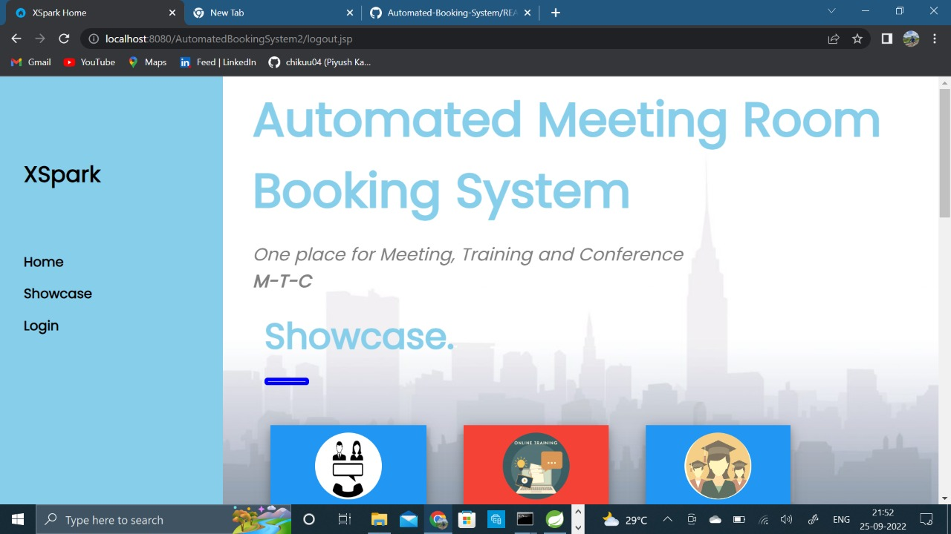
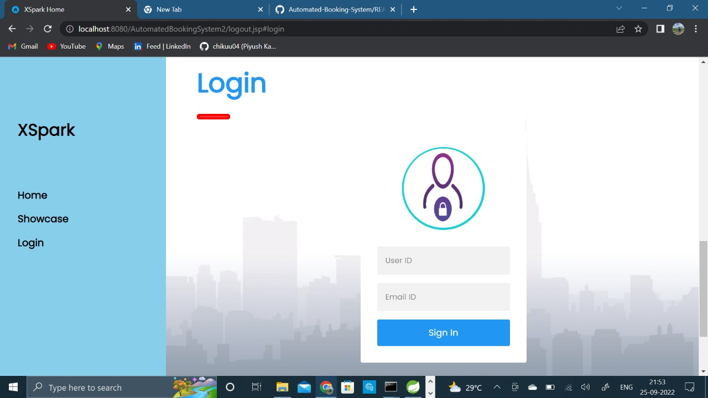
SNAPSHOTS

Slide 8
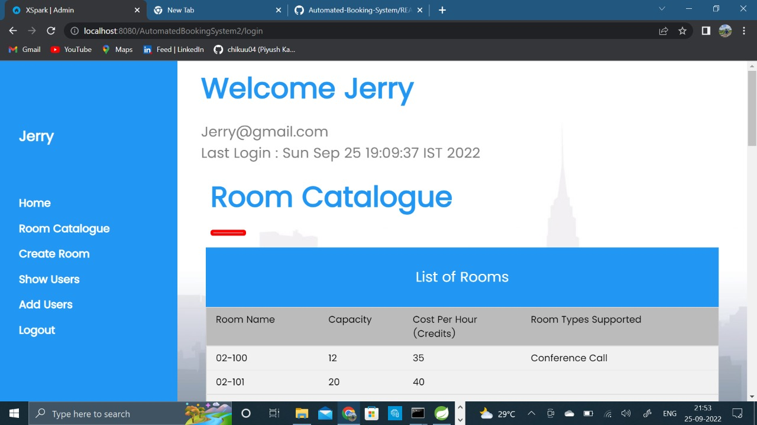
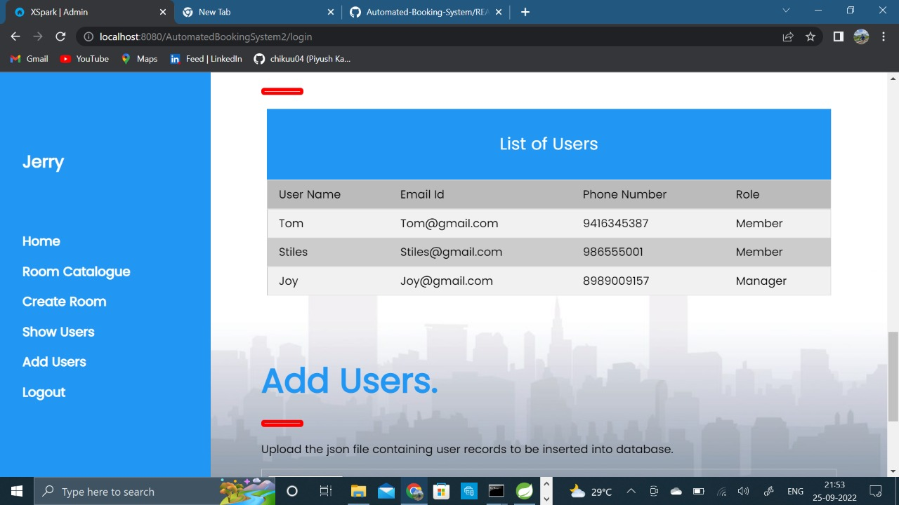

Slide 9
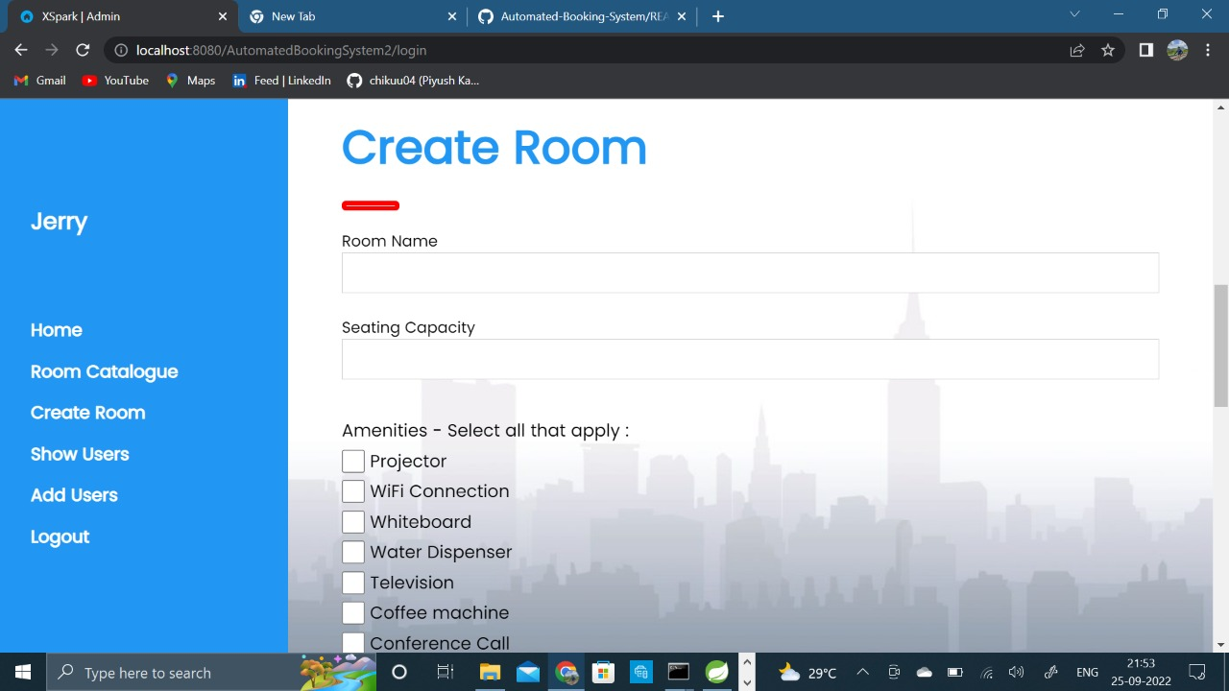
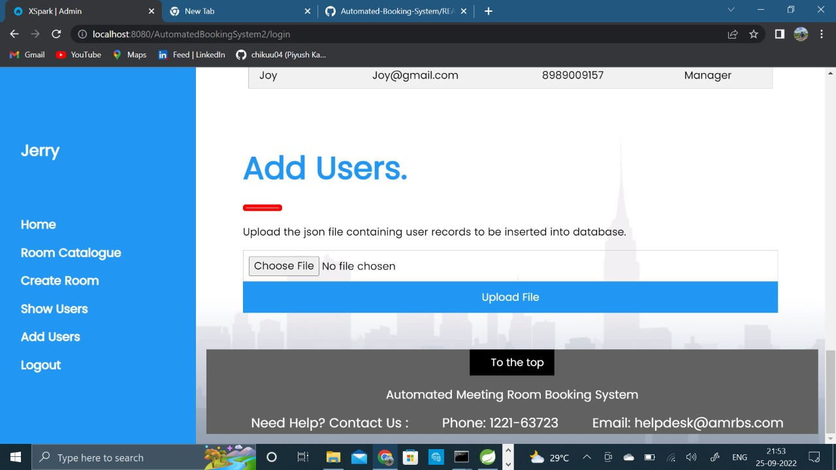

Slide 10
THANK YOU!!!!

